Slide 1
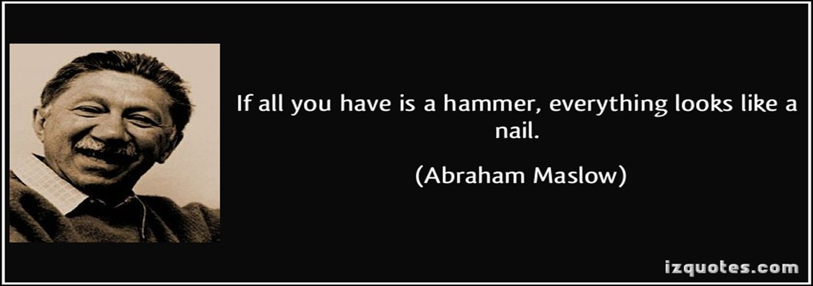

Slide 2
From SQL to NoSQL in 10 minutes with Azure DocumentDB
Santosh Hari

Slide 3

Azure MVP
Document DB Wizard
Dir of Tech: Spectrum Bridge
Consultant: Sand Dollar
ONETUG & Orlando Codecamp
Email: s.hari@sanddollartechnology.com
Twitter: @_s_hari

Slide 4
Agenda
Intro
Why DocumentDB
Develop local & deploy to the cloud
Core concepts – resource hierarchy, consistency, throughput, partitioning
Tools – Emulator, Calculator, Query Playground
Notes:
What is DocumentDB?
I always like to start with the “why” 0
10 minute demo to run Document DB on your local machine - including an ASP.NET MVC app to perform CRUD
Once the web app is created we’ll run the code against an Azure instance
Then we’ll discuss some core concepts like layout, performance and tuning
Finally, some tools

Slide 5
Azure Document DB
Fully managed Azure-based NoSQL document database-as-a-service
Built for fast and predictable performance, high availability, automatic scaling, and ease of development
Allows flexible data model, consistent low latencies, and rich query capabilities
Great fit for web, mobile, gaming, and IoT, and many other applications that need seamless scale
Notes:
DocumentDB is a fully managed NoSQL database service
built for fast and predictable performance,
high availability, elastic scaling, global distribution, and ease of development.
As a schema-free NoSQL database,
DocumentDB provides rich and familiar SQL query capabilities
with consistent low latencies on JSON data.
These unique benefits make DocumentDB a great fit for web, mobile, gaming, and IoT, and many other applications that need seamless scale and global replication.

Slide 6
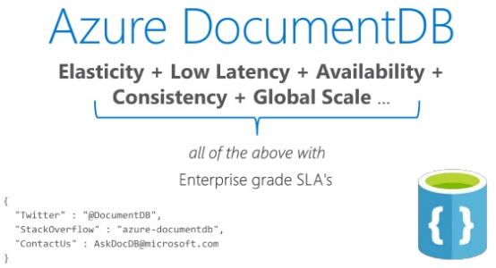
Notes:
Guaranteed low latency
less than 10 ms on reads and less than 15 ms latencies on writes for at least 99% of requests. leverages a write-optimized, latch-free database engine designed for high-performance solid-state drives to run in the cloud at global scale. Read and write requests are always served from your local region while data can be distributed to other regions across the globe.
Achieve limitless scale for NoSQL databases
Scale data throughput and storage independently and elastically—not just within one region, but across many geographically distributed regions. Add capacity to serve millions of requests per second at a fraction of the cost of other popular NoSQL databases.
More choices for consistency
Instead of offering extreme choices between strong and eventual consistencies, DocumentDB offers four well-defined consistency levels—strong, bounded staleness, session, and eventual—for an intuitive programming model with low latency and 99.99 percent availability in the face of local and regional failures.

Slide 7
Why use Azure Document DB
Allows SQL
CRUD friendly
JSON data
SP, UDF, Triggers
JS/MongoDB friendly
*Some ACID*
.NET and SQL Server dev friendly
Notes:
Allows (subset of) SQL queries
CRUD friendly
JSON data – easy to consume
Support for SP, UDF, Triggers
Easy to translate Javascript and MongoDB skills
Support some ACID transactions – docs within 1 collection
Easiest jump for .NET and SQL Server devs to NoSQL

Slide 8
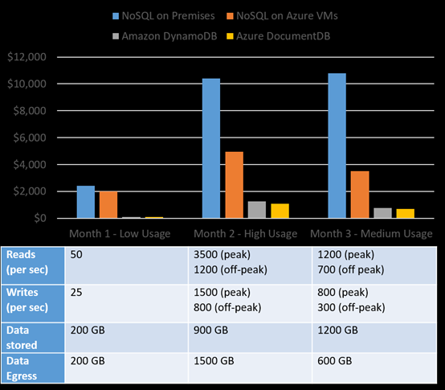
TCO: Total cost of (non) ownership
Notes:
My #1 reason:
OSS NoSQL database like Cassandra or MongoDB hosted on-premises
OSS NoSQL database hosted on Azure Virtual Machines
Using a managed NoSQL database as a service such as Azure DocumentDB.
No NoSQL administration dev/ops required. managed cloud service, you do not need a dev/ops team to handle deployments, maintenance, scale, patching and other day-to-day tasks required with an OSS NoSQL cluster hosted on-premises or on cloud infrastructure.
Superior elasticity throughput can be scaled up and down within seconds, allowing you to reduce the cost of ownership during non-peak times. OSS NoSQL clusters deployed on cloud infrastructure offer limited elasticity, and on-premises deployments are not elastic.
Economy of scale. Managed services operating really large number of nodes, and are able to pass on savings to the customer.
Cloud optimized. Managed services take full advantage of the cloud. OSS NoSQL databases at the moment are not optimized for specific cloud providers. For example, OSS NoSQL software is unaware of the differences between a node going down vs a routine image upgrade, or the fact that premium disk is already three-way replicated.

Slide 9
Azure products compatible with DocumentDB
Azure Search
Azure App Services
Azure Blob Storage
Azure SQL Database
Azure Machine Learning
Notes:
Azure Search can be used via the web app to enable users to search for posts.
Azure App Services can be used to host applications and background processes.
Azure Blob Storage can be used to store full user profiles including images.
Azure SQL Database can be used to store massive amounts of data such as login information, and data for usage analytics.
Azure Machine Learning can be used to build knowledge and intelligence that can provide feedback to the process and help deliver the right content to the right users.

Slide 10
When to not use Azure DocumentDB
No local dev instance … yet Limited local dev instance
Complex relationships
Rigid schemas
Complex transactions
Aggregation
Encrypted storage
Don’t move entire datastore to DocumentDB/NoSQL
Don’t like magic
Notes:
Complex relationships – obvious (denormalized data and flex schema)
Rigid schema – for instance if your data was imported from XML docs
Complex transactions – supports some but can’t cross boundaries
Aggregation – since some properties could be present or not, it’s not a good fit for data aggregation. The SQL does support some aggregation now
Encrypted data storage – protocol is encrypted, data is not. No current in-built mechanisms for encrypted data storage
Moving entire datastore to Azure DocumentDB – use as supplement not replacement

Slide 11
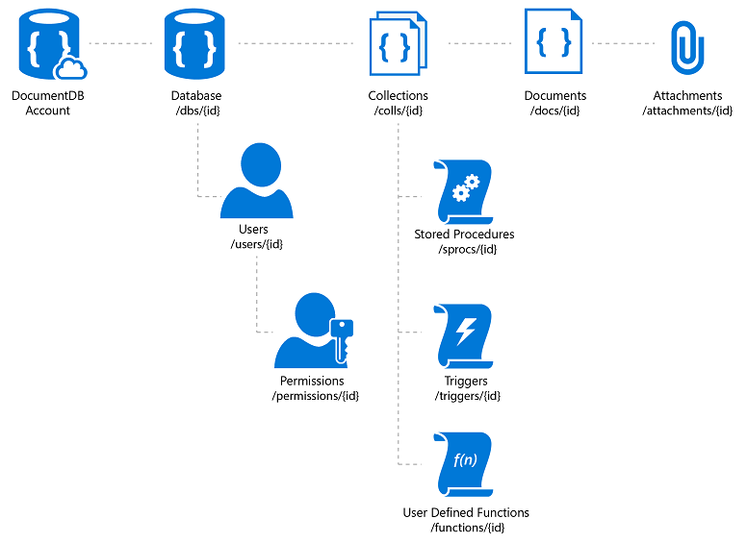
Azure DocumentDB Resources
Database
User
Collection
Stored Procedure
Trigger
User-defined Function (UDF)
Document
Attachment
Notes:
Database
A database is a logical container of document storage partitioned across collections. It is also a users container.
User
The logical namespace for scoping permissions.
Permission
An authorization token associated with a user for access to a specific resource.
Collection
A collection is a container of JSON documents and the associated JavaScript application logic.
Stored Procedure
Application logic written in JavaScript which is registered with a collection and transactionally executed within the database engine.
Trigger
Application logic written in JavaScript executed before or after either an insert, replace or delete operation.
UDF
Application logic written in JavaScript. UDFs enable you to model a custom query operator and thereby extend the core DocumentDB query language.
Document
Arbitrary user-defined JSON content. By default, no schema needs to be defined nor do secondary indices need to be provided for all the documents added to a collection.

Slide 12
Let’s code
Download tools and code
https://docs.microsoft.com/en-us/azure/documentdb/documentdb-nosql-local-emulator
Develop local
Run against DocumentDB on Azure

Slide 13
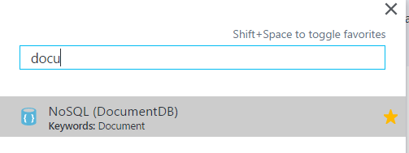

Slide 14
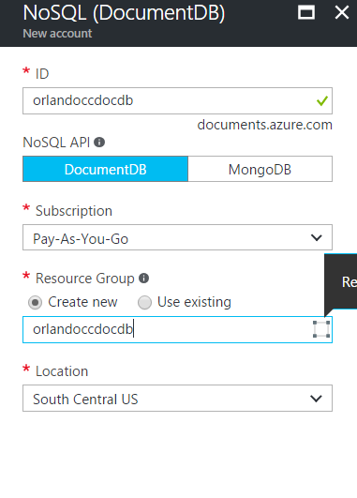

Slide 15
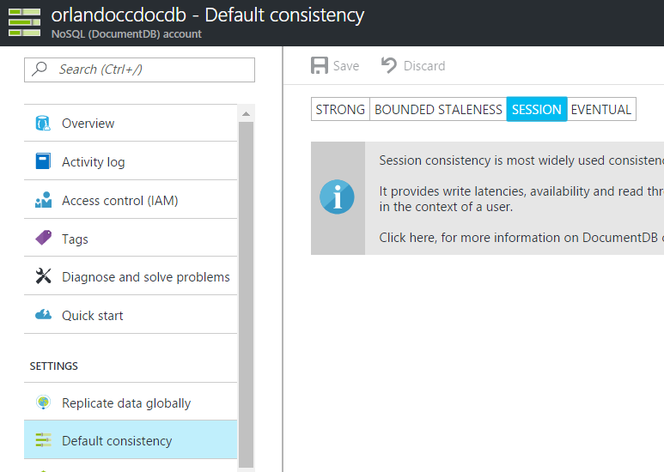

Slide 16
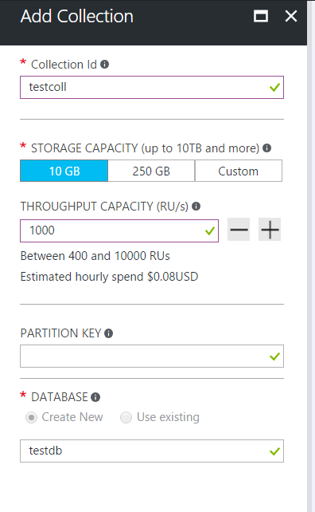

Slide 17
Scale horizontal many servers
Application
DocDB
DocDB
DocDB
Notes:
As application usage increases keep adding nodes
Even if nodes fail, system is able to keep responding
NoSQL scale out – run on commodity hardware on multiple nodes
Easy to add and remove nodes to handle loads
No single PoF
Flexibility in handling trade offs (CAP Theorem)

Slide 18
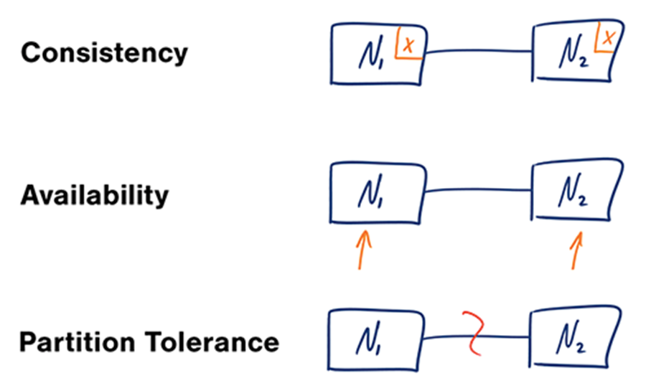
CAP Theorem
Notes:
Consistency - A read is guaranteed to return the most recent write for a given client.
Availability - A non-failing node will return a reasonable response within a reasonable amount of time (no error or timeout).
Partition Tolerance - The system will continue to function when network partitions occur.
Widely distributed aka networking factors comes into play. Object Oriented Programming != Network Programming.
One such fallacy of distributed computing is that networks are reliable. They aren’t. Networks and parts of networks go down frequently and unexpectedly. Network failures happen to your system and you don’t get to choose when they occur.

Slide 19
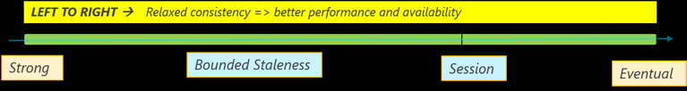
Consistency
Strong – highest latency RW, highest C (dev)
Session (default) – low latency + high C within a session, not so great system wide (good for data entry people)
Bounded Staleness – low latency + predictable consistency system wide (prod)
Eventual – lowest latency RW, weakest C (prod)
Notes:
Strong: Strong consistency guarantees that a write is only visible after it is committed durably by the majority quorum of replicas. Strong consistency provides absolute guarantees on data consistency, but offers the lowest level of read and write performance
Session: ability to read your own writes. A read request for session consistency is issued against a replica that can serve the client requested version (part of the session cookie). Session consistency provides predictable read data consistency for a session while offering the lowest latency writes. Reads are also low latency as except in the rare cases, the read will be served by a single replica.
Bounded staleness: provides more predictable behavior for read consistency while offering the lowest latency writes. As reads are acknowledged by a majority quorum, read latency is not the lowest offered by the system. This provides a stronger guarantee than Session or Eventual.
Eventual: weakest form of consistency wherein a client may get the values which are older than the ones it had seen before, over time. In the absence of any further writes, the replicas within the group will eventually converge. The read request is served by any secondary index.
Eventual consistency provides the weakest read consistency but offers the lowest latency for both reads and writes.

Slide 20
Throughput
Measured in RUs, 1 RUs = throughput for a 1KB document/second
Create document | ~15 RU
Read document | ~1 RU
Query document by id | ~2.5 RU
Query | Request Unit Charge | # of Returned Documents
Select food by id | ~2.5 RU | 1
Select foods by manufacturer | ~7 RU | 7
Select by food group and order by weight | ~70 RU | 100
Select top 10 foods in a food group | ~10 RU | 10
Notes:
Throughput = amount of items passing through a system

Slide 21
Throughput
Azure RU estimator
https://azure.microsoft.com/en-us/blog/estimate-throughput-requirements-for-documentdb-applications/
Notes:
Throughput = amount of items passing through a system

Slide 22
Partitions
Physical entities for storing collections
SSD storage with repl for high avail
Managed by Azure, transparent to app
Uses partition key – groups docs by PK
Notes:
Partition key is a hash
Documents with same PK stored in same partition
Example department could be PK for employees
to achieve full throughput of collection, choose PK that allows you to evenly distribute requests

Slide 23
Indexing
Auto
Consistent
Lazy
https://github.com/onetug
Notes:
Auto
Choose whether the collection automatically indexes all of the documents or not. By default, all documents are automatically indexed. You can choose to turn off automatic indexing and selectively add only specific documents to the index. Conversely, you can selectively choose to exclude only specific documents
Sync and Lazy
Choose between synchronous (consistent) and asynchronous (lazy) index updates. By default, the index is updated synchronously. Lazy indexing boosts the write performance further and is ideal for bulk ingestion scenarios for primarily read-heavy collections.

Slide 24
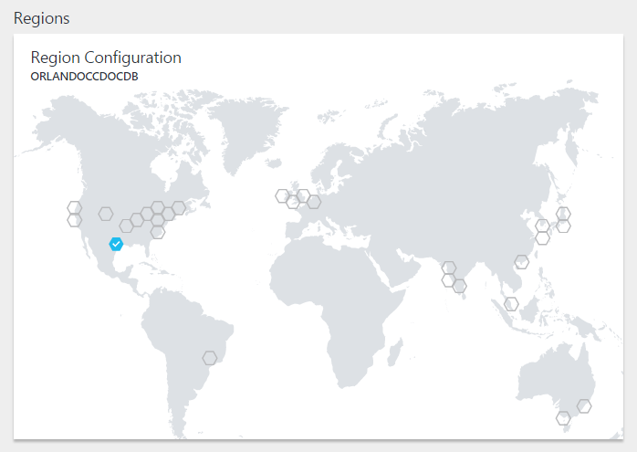

Slide 25
Query your data
Use Query Explorer
DocumentDB query playground
https://www.documentdb.com/sql/demo
Cheat sheet
https://azure.microsoft.com/en-us/documentation/articles/documentdb-sql-query-cheat-sheet/

Slide 26
Use cases
User generated
Catalog
Logging and Time-series
Gaming
User preferences
IoT and Device sensor
Notes:
UGC in social media applications is a blend of free form text, properties, tags and relationships \not bounded by rigid structure.
Content such as chats, comments, and posts can be stored in DocumentDB without requiring transformations or complex object to relational mapping layers.
Data properties can be added or modified easily to match requirements as developers iterate over the application code, thus promoting rapid development.
Catalog Data - Attributes for this data may vary and can change over time to fit application requirements.Consider an example of a product catalog for an automotive parts supplier. Every part may have its own attributes in addition to the common attributes that all parts share. Furthermore, attributes for a specific part can change the following year when a new model is released. As a JSON document store, DocumentDB supports flexible schemas and allows you to represent data with nested properties, and thus it is well suited for storing product catalog data.
Logging - perform ad-hoc queries over a subset of data for troubleshooting. Subset of data is first retrieved from the logs, typically by time series. Then, a drill-down is performed by filtering the dataset with error levels or error messages.Long running data analytics jobs performed offline over a large volume of log data. Examples of this use case include server availability analysis, application error analysis, and clickstream data analysis. Typically, Hadoop is used to perform these types of analyses with data from DocumentDB using Hadoop connector
Gaming - handle updating profile and stats from millions of simultaneous gamersmillisecond reads and writes to help avoid any lagsautomatic indexing allows for filtering against multiple different properties in real-time
User preferences data - most modern web and mobile applications come with complex views and experiences. These views and experiences are usually dynamic, catering to user preferences or moods and branding needs. Hence, applications need to be able to retrieve personalized settings effectively in order to render UI elements and experiences quickly.
IOT - Bursts of data can be ingested by Azure Event Hubs as it offers high throughput data ingestion with low latency. Data ingested that needs to be processed for real time insight can be funneled to Azure Stream Analytics for real time analytics. Data can be loaded into DocumentDB for adhoc querying. Once the data is loaded into DocumentDB, the data is ready to be queried. The data in DocumentDB can be used as reference data as part of real time analytics. In addition, data can further be refined and processed by connecting DocumentDB data to HDInsight for Pig, Hive or Map/Reduce jobs. Refined data is then loaded back to DocumentDB for reporting.

Slide 27
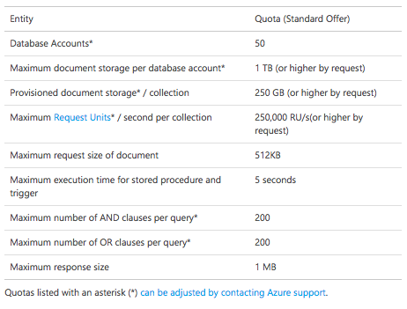
Limits

Slide 28
Document Studio
Open source client management viewer/explorer
https://github.com/mingaliu/DocumentDBStudio

Slide 29
Migration tool
Source Code: https://github.com/azure/azure-documentdb-datamigrationtool
Compiled version: http://www.microsoft.com/downloads/details.aspx?FamilyID=cda7703a-2774-4c07-adcc-ad02ddc1a44d
Imports from these sources:
Json
CSV
Mongo
SQL Server
Azure Table
And many more
https://azure.microsoft.com/en-us/documentation/articles/documentdb-import-data/

Slide 30
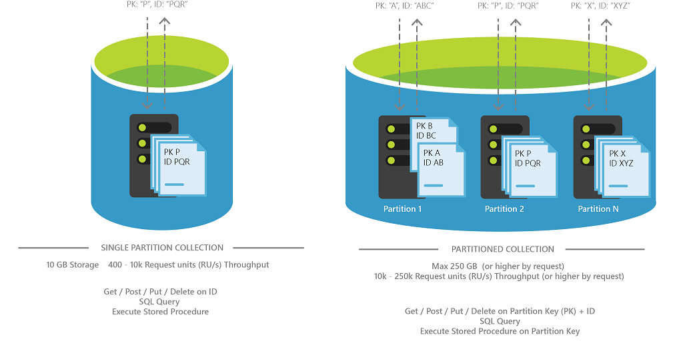
Partitions
SINGLE
PARTITIONED
LOW DATA VOLUME
MAX 10GB, 10K RUs
SIMPLE KEY (id)
HIGH DATA VOLUME
MAX 250GB (unlimited), 250K RUs
COMPOUND KEY (PK+id)
Notes:
Partitioned collections can span multiple partitions and support very large amounts of storage and throughput. You must specify a partition key for the collection.
Single-partition collections have lower price options and the ability to query and perform transactions across all collection data. They have the scalability and storage limits of a single partition. You do not have to specify a partition key for these collections.

Slide 32
SQL v/s NoSQL
 | SQL | NoSQL
Model | Relational | Non-relational
Storage | Tables | JSON docs, Key-value pairs, column stores, graphs
Data Properties | Every record in table has same properties | Flexibility in properties varies across records
Relationships | Uses joins | Uses denormalization
Schema | Strict | Flexible
ACID transactions | Supports | Varies by solution
Data Consistency | Strong | Variable
Scale | Vertical | Horizontal

Slide 33
SQL or NoSQL
NoSQL is a supplement/complement to SQL
Or vice versa
NOT a replacement
Polyglot persistence

Slide 34
Types of NoSQL
Document databases - JSON documents. Mongo, Azure DocumentDB
Graph stores - Neo4J and Graph.
Key-value stores - Redis
Wide-column - Cassandra and Hbase
Notes:
Document databases pair each key with a complex data structure known as a document. Documents can contain many different key-value pairs, or key-array pairs, or even nested documents. Mongo, Azure DocumentDB
Graph stores are used to store information about networks of data, such as social connections. Graph stores include Neo4J and Giraph.
Key-value stores are the simplest NoSQL databases. Every single item in the database is stored as an attribute name (or 'key'), together with its value. Examples of key-value stores are Riak and Berkeley DB. Some key-value stores, such as Redis, allow each value to have a type, such as 'integer', which adds functionality.
Wide-column stores such as Cassandra and HBase are optimized for queries over large datasets, and store columns of data together, instead of rows.

Slide 35




NoSQL on Azure
 | DocumentDB | Table Storage | HBase | Redis Cache
Tech | Document | Key Value | Column Family | Redis (Key-Value)
Data storage | JSON docs on SSD | Entities in key-value pairs | Tables, rows, columns | In-mem Key-value
Query | SQL subset | oData subset | Hive and SQL subset | Command for search
Transaction boundaries | All docs in 1 collection | All entities in 1 partition | All cells in 1 row | Atomic operations
SP, UDF, Triggers | Yes | No | No | No

Slide 36
Stored Proc!

Slide 37
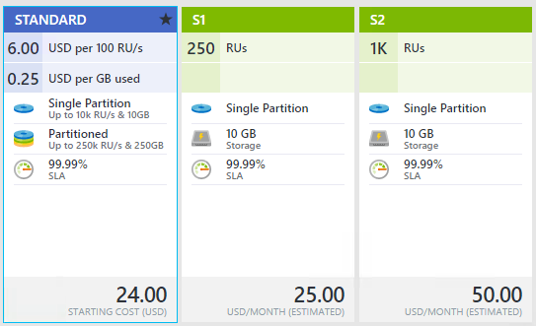
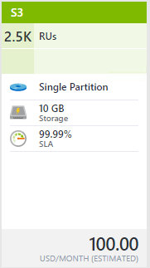
Collections - Tiers
Throughput, partitioning and storage
Notes:
Standard – pay as you go, allows partitioning, storage measured in GB, 400-250K RUs, 250GB storage max (can be increased)
S1, S2, S3 – predefined. 10GB storage max, throughput max 2.5K RUs

Slide 38
Collections - Throughput
What happens when you exceed provisioned throughput?
HTTP Status 429 Status Line: RequestRateTooLarge x-ms-retry-after-ms :100

Slide 39
Collections - Throughput
Factors
Document size
Document property count
Data consistency
Indexed properties
Document indexing
Query patterns complexity
Notes:
Document size - As units inc, read inc, write inc
Document property count - As pc inc, write units inc
Data consistency - consistency levels of Strong or Bounded Staleness, read units inc
Indexed properties - As index decrease, read units dec, write units dec. Look at lazy indexing.
Document indexing - By default each document automatically indexed, if you choose not to index some of your documents - read dec, write dec
Query patterns - As complexity of a query (number of predicates, nature of predicates, projections, number of UDFs, and size of source data set) inc, read inc, write inc

Slide 40
NoSQL
NoSQL is a marketing misnomer, it should be non-relational databases
Primary USPs
develop with agility
operate at any scale

Slide 41
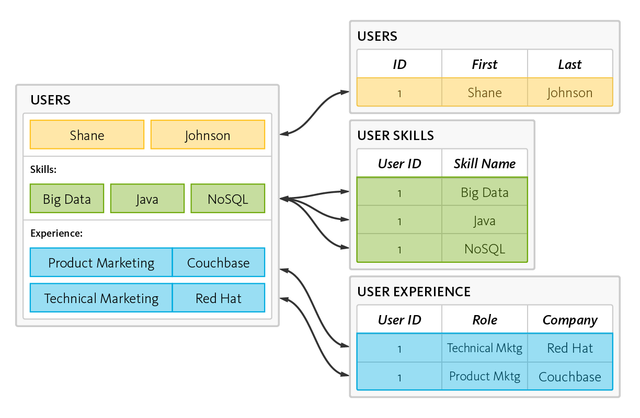
RDBMS – Reads, Writes, data shredding and reassembling
Notes:
data is read and written by disassembling, or “shredding,” and reassembling objects
This is the object-relational “impedance mismatch.” The workaround is object-relational mapping frameworks, which are inefficient at best, problematic at worst.

Slide 42
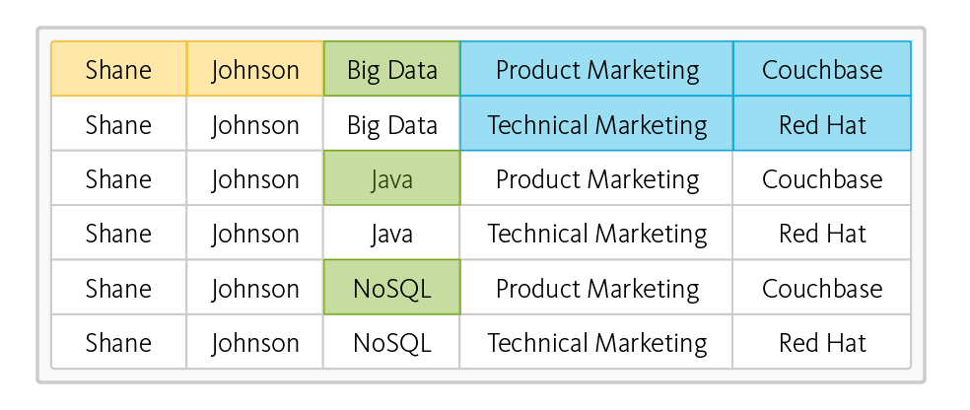
RDBMS – read operation – takes six rows from three tables
Impedance Mismatch
Notes:
This is the object-relational “impedance mismatch.” The workaround is object-relational mapping frameworks, which are inefficient at best, problematic at worst.

Slide 43
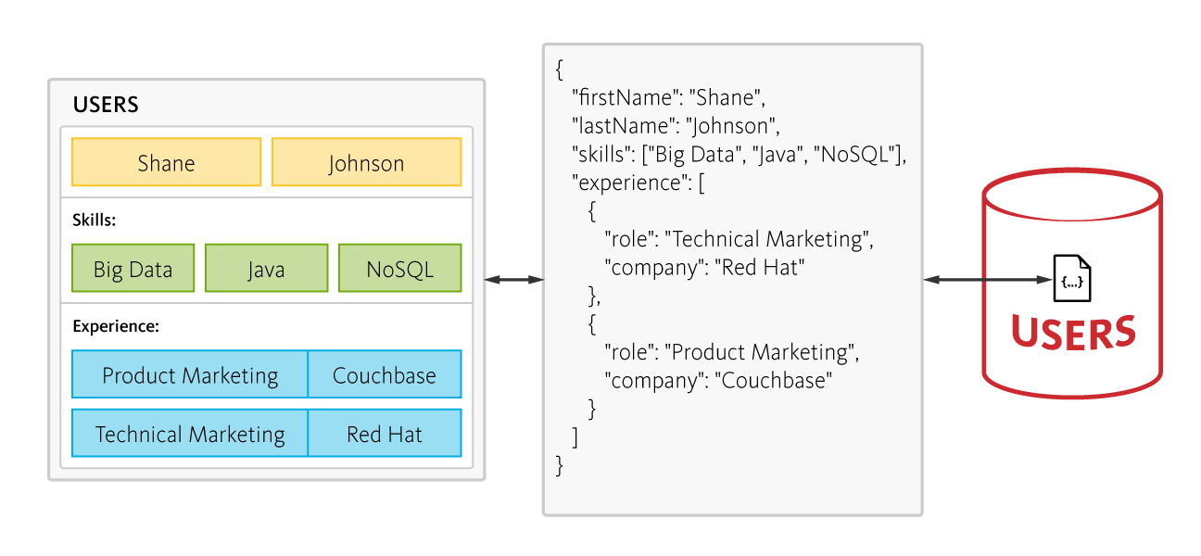
NoSQL – 6 rows of data, no joins, one fetch
Notes:
In contrast, a document-oriented NoSQL database reads and writes data formatted in JSON – which is the de facto standard for consuming and producing data for web, mobile, and IoT applications. It not only eliminates the object-relational impedance mismatch, it eliminates the overhead of ORM frameworks and simplifies application development because objects are read and written without “shredding” them – i.e., a single object can be read or written as a single document, as illustrated here:
DO NOT SWITCH SOLELY FOR THIS REASON!!!

Slide 44
RDBMS – Scale Vertical Single Server
Concurrent Connections
Application
L
Server load
M
S
Increase in Users
Notes:
Database has to be able to scale reads, writes, and storage
Several years ago, building performance into a software system was simple - you either increased your hardware resources (scale up) or modified your application to run more efficiently (performance tuning). Today, there’s a third option: horizontal scaling (scale out).

Slide 45
RDBMS – Scale Vertical Single Server
Concurrent Connections
Negative User Experience
Server efficiency
Postive User Experience
Server load
Unused
Capacity
Increase in Users
Notes:
Scaling up on single machine
User experience good until server efficiency reached
After exceeding server efficiency, user experience sucks
Almost half of capacity unused
Horizontal scaling – positives – unlimited scaling – negative – complexity
Data records vary across clients/nodes in different locations. Single points of failure destroy system up-time, and intermittent network issues creep up at the worst possible time

Slide 46
Some NoSQL basics
CAP Theorem
Consistency, Availability and Parititioning
3Vs
Volume, Velocity and Variety

Slide 47
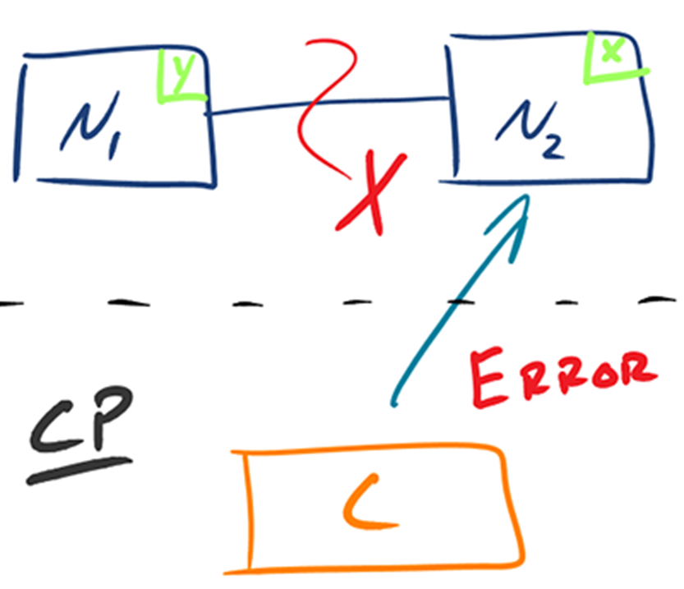
CAP Reality 1 – Consistent+Partition Tolerant
Notes:
Given that networks aren’t completely reliable, you must tolerate partitions in a distributed system, period. Fortunately, though, you get to choose what to do when a partition does occur.
Wait for a response from the partitioned node which could result in a timeout error
OR
The system can also choose to return an error, depending on the scenario you desire.
Choose Consistency over Availability when your business requirements dictate atomic reads and writes.

Slide 48
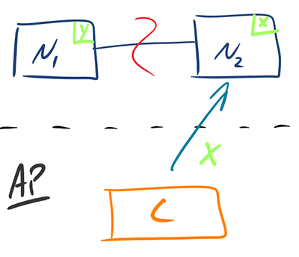
CAP Reality 2 – Availability + Partition Tolerant
Notes:
Return the most recent version of the data you have, which could be stale.
This system state will also accept writes that can be processed later when the partition is resolved.
Choose Availability over Consistency when your business requirements allow for some flexibility around when the data in the system synchronizes.
Availability is also a compelling option when the system needs to continue to function in spite of external errors (shopping carts, etc.)

Slide 49
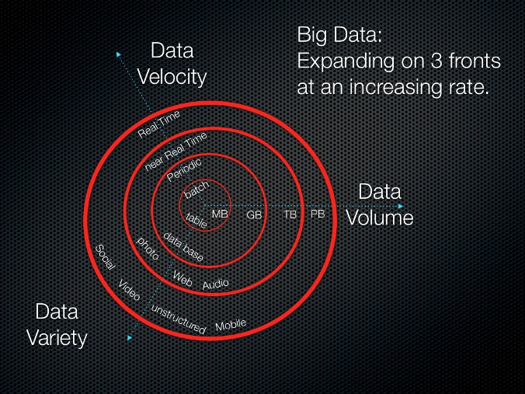
3Vs
Notes:
Volume: Facebook has over 250 billion images in 2015, ToDoList has 10 million installs
Velocity: Facebook has over 900 million photos/day.
Variety: Some large company CRMs have data in spreadsheets, docs, pdfs, audio, video, emails and so on

Slide 50
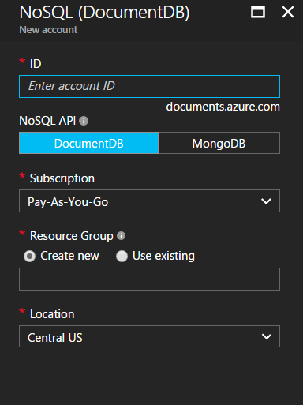

Slide 51
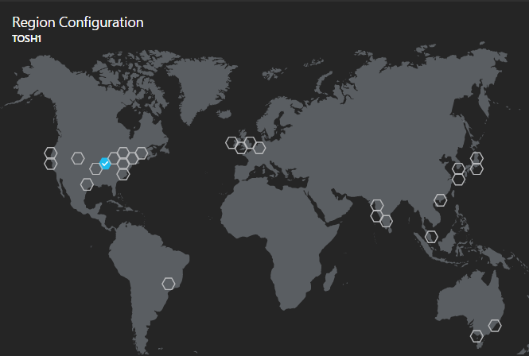

Slide 52
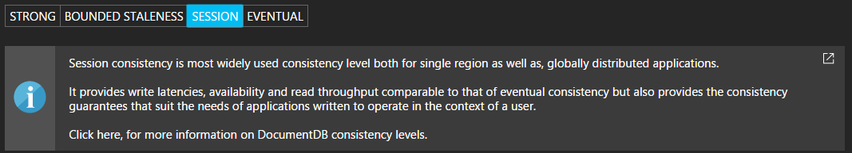

Slide 53
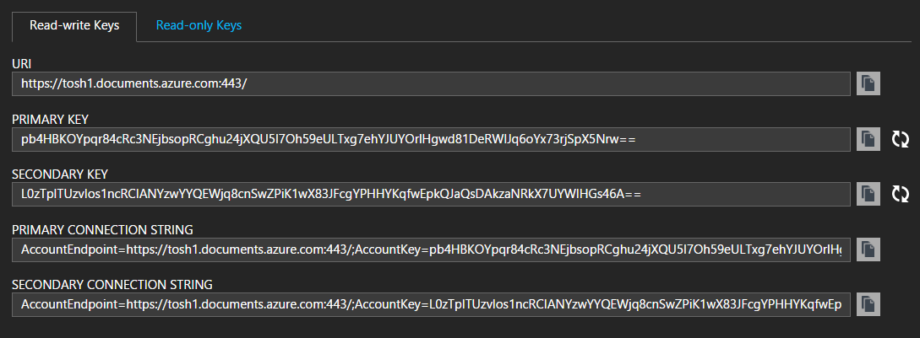

Slide 54
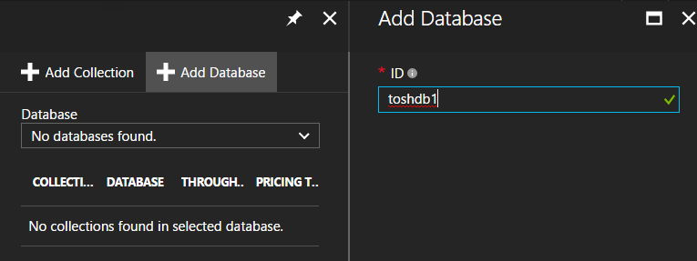

Slide 55
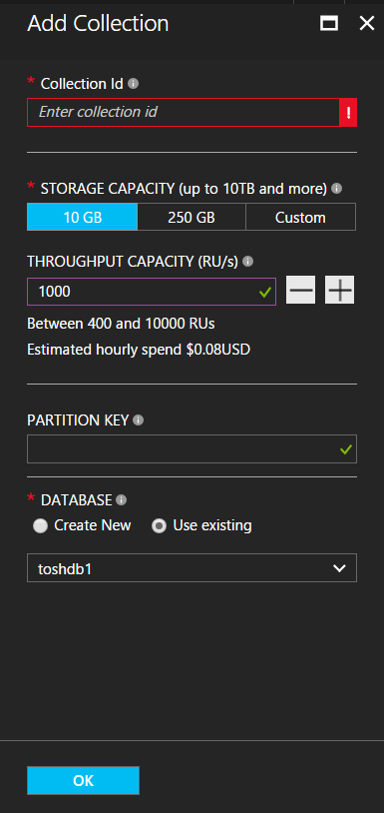

Slide 56
